Slide 1
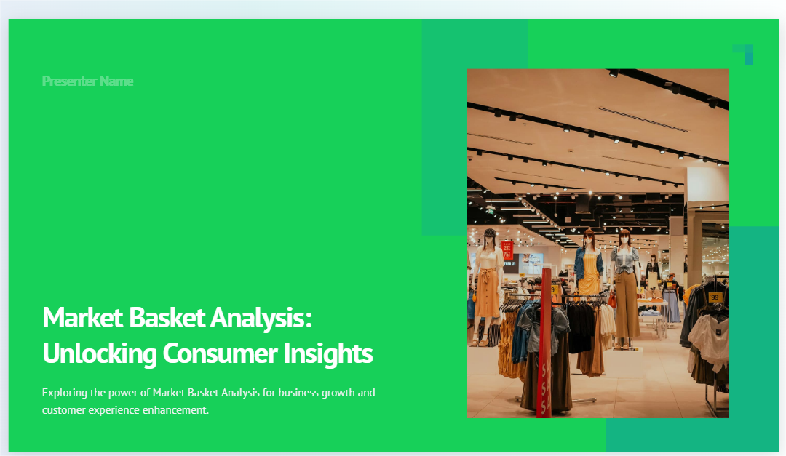

Slide 2
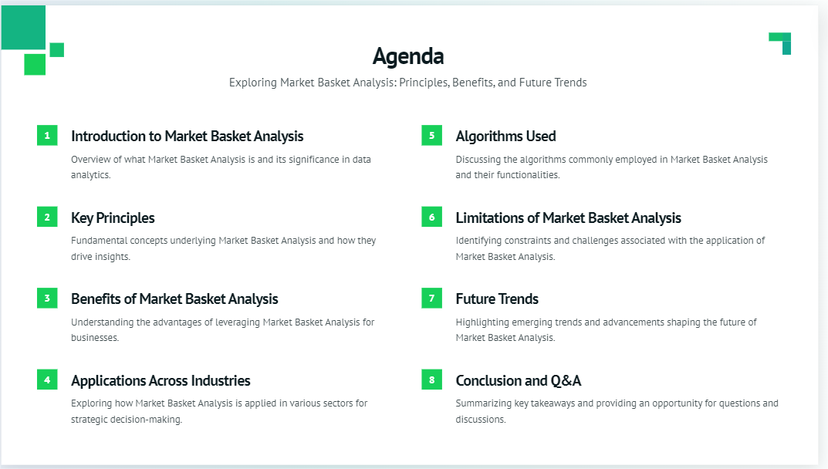

Slide 3



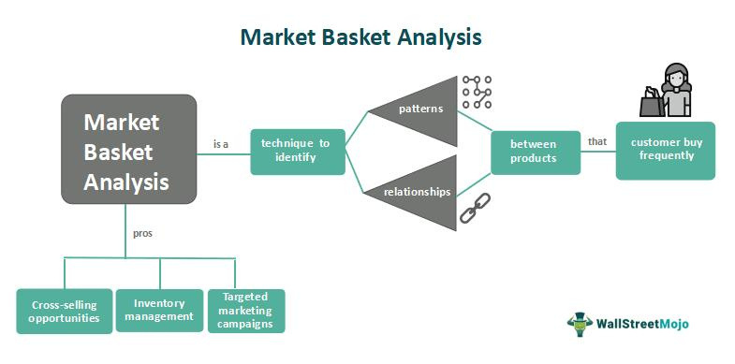


INTRODUCTION
Businesses are constantly seeking ways to optimize their product offerings, increase sales, and enhance customer satisfaction. One powerful technique that has gained significant traction is Market Basket Analysis. This method goes beyond traditional sales data by uncovering hidden patterns in customer purchases.

Slide 4
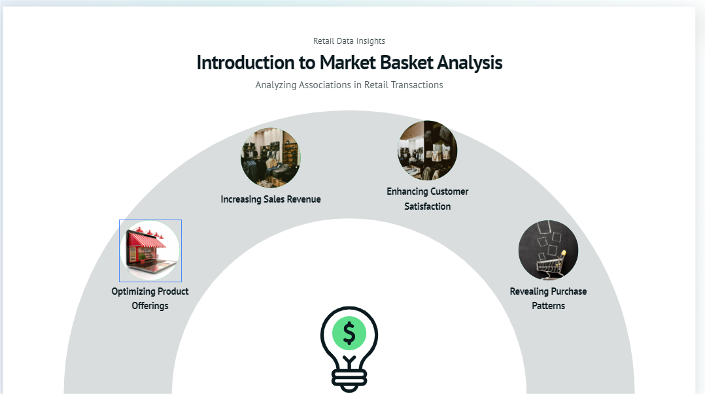
MOTIVATION
The motivation for choosing this topic stems from the immense value that Market Basket Analysis can bring to various industries. Whether it’s a retail store looking to increase its cross-selling opportunities or an e-commerce platform aiming to improve its recommendation engine, the insights gained from this analysis can drive tangible improvements in both revenue and customer experience.

Slide 5
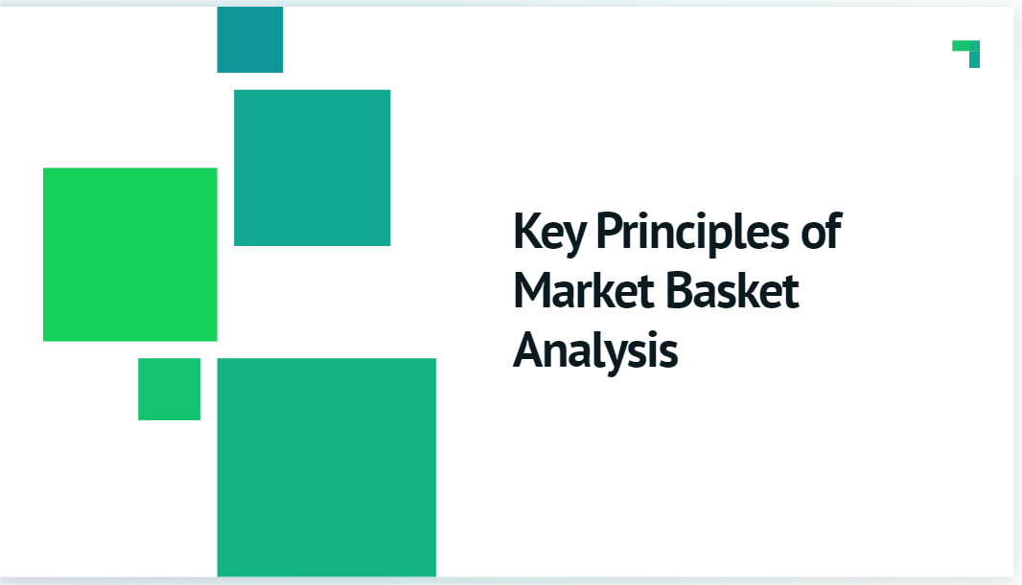

Slide 6
APPLICATION OF MARKET BASKET ANALYSIS
MARKET BASKET ANALYSIS (MBA) IS A DATA MINING TECHNIQUE PRIMARILY USED TO IDENTIFY ASSOCIATIONS OR PATTERNS BETWEEN ITEMS IN LARGE DATASETS, PARTICULARLY IN RETAIL TRANSACTIONS. THIS METHOD HELPS IN UNDERSTANDING CONSUMER BEHAVIOR BY REVEALING RELATIONSHIPS BETWEEN PRODUCTS THAT ARE FREQUENTLY BOUGHT TOGETHER.

Slide 7
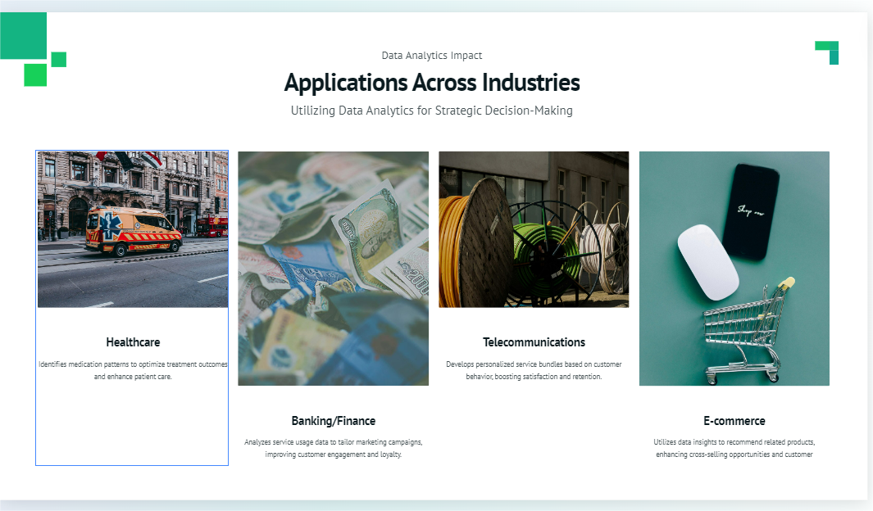

Slide 8
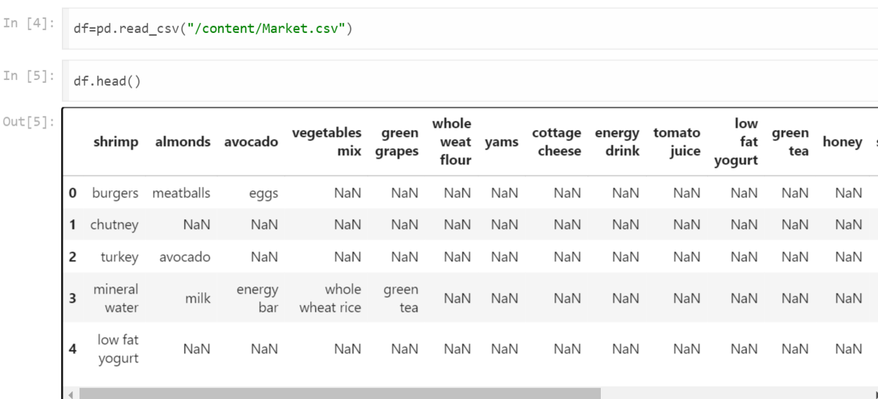
Details about the Dataset-
The dataset that can be used for the Market Basket Analysis-https://www.kaggle.com/datasets/sivaram1987/association-rule-learningapriori
This dataset contains a total of 7501 transaction records, where every record consists of a list of items sold in just one transaction.
Overview-

Slide 9
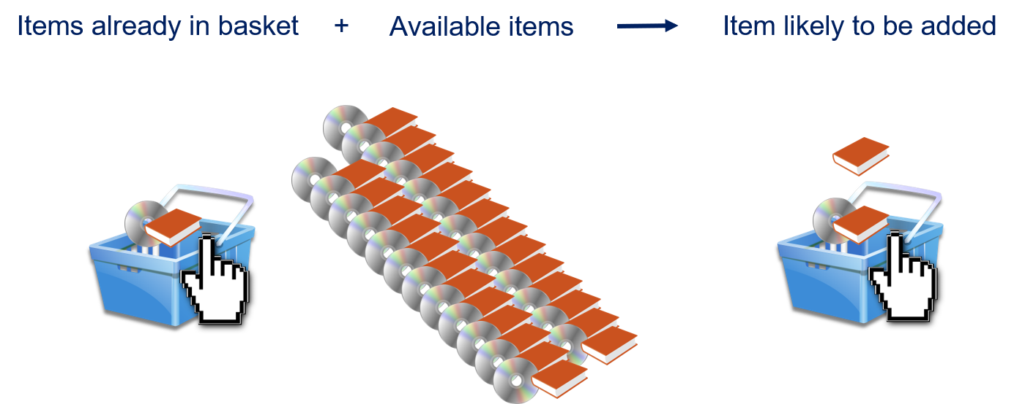
Association Mining
Association mining, also known as association rule mining, is a key technique in data mining used to uncover interesting relationships and patterns between variables in large datasets. It’s widely used in market basket analysis, where the goal is to identify associations between products purchased together.

Slide 10
Principles-
1.Frequent Itemsets:
A frequent itemset is a set of items that appear together in a dataset with a frequency that meets or exceeds a predefined threshold (support).
Association Rules-
1.Support:
Support measures the frequency or proportion of transactions in which a particular itemset appears. It’s essentially a way to gauge how popular an item or itemset is.
2.Confidence:
Confidence measures the likelihood that an item B is purchased given that item A is purchased. It’s a conditional probability that helps understand the strength of the association between two items.
3.Lift:
Lift measures the strength of an association rule over the baseline expectation of the items being independent. It compares the observed support of the itemset to what would be expected if the items were independent.
In summary, support gives an idea of how frequently items are bought, confidence shows how often items are bought together when one is already purchased, and lift reveals the strength of the association relative to what would be expected by chance.

Slide 11
1.Apriori Algorithm-
1.The Apriori algorithm is a fundamental technique used in market basket analysis, a type of data mining that focuses on discovering interesting relationships between items in large datasets, often used in retail to understand consumer behavior.
2. The primary goal of the Apriori algorithm is to identify frequent itemsets and generate association rules from transactional data. Frequent itemsets are combinations of items that appear together in transactions with a frequency above a specified threshold.

Slide 12
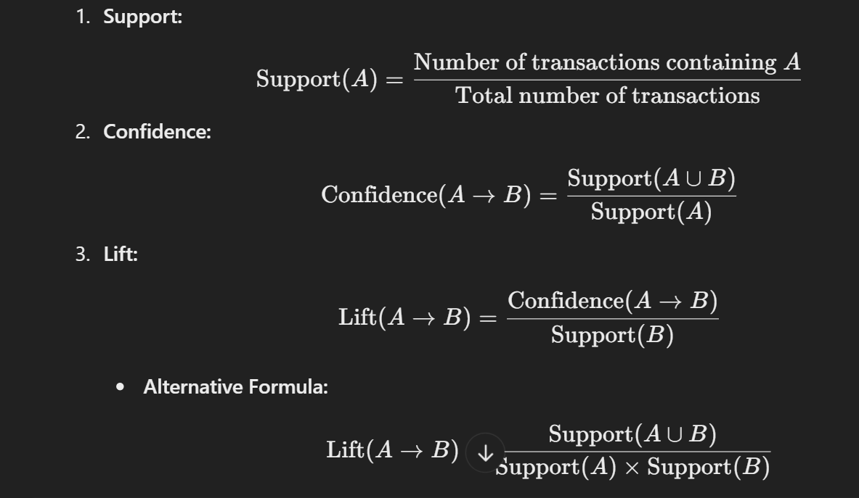
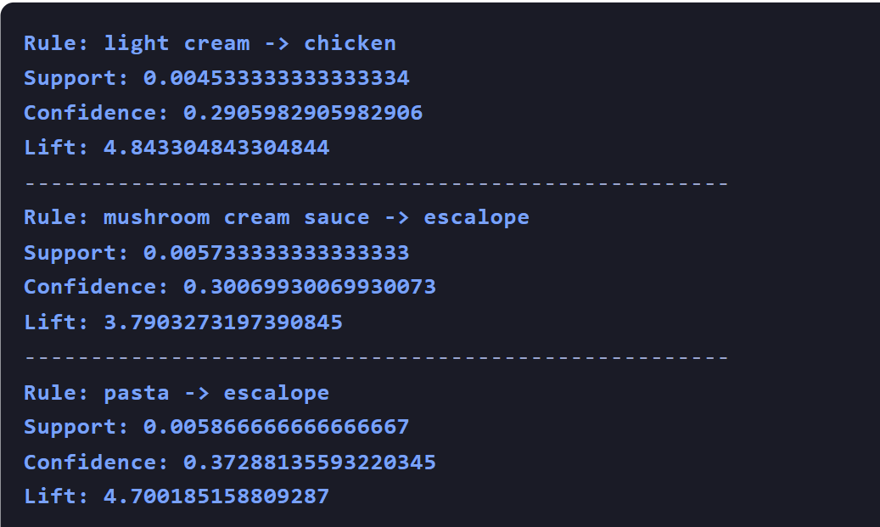

Slide 13
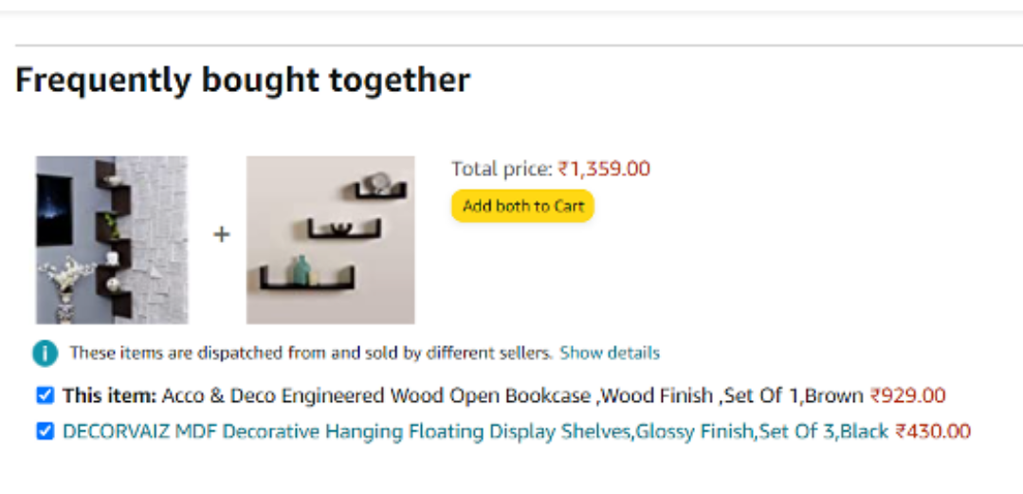
Example

Slide 14
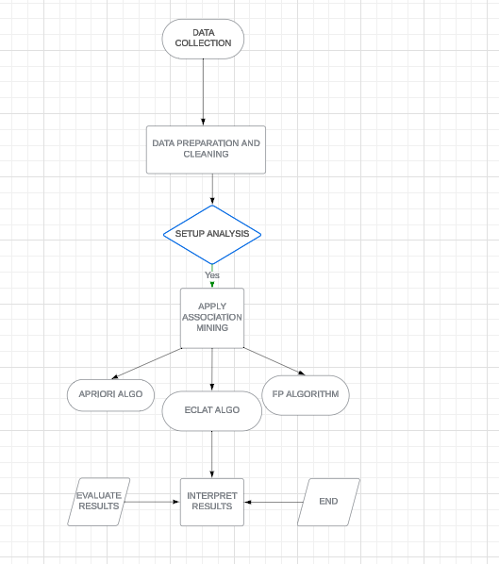
Flowchart

Slide 15
ECLAT ALGORITHM
The ECLAT algorithm works by using a depth-first search approach to find frequent item sets. ECLAT focuses on a vertical data format. This means that instead of working with transactions and items directly, ECLAT works with tidsets (Transaction ID sets), where each item is associated with a list of transaction IDs in which it appears.
Steps Involved in ECLAT:
1.Vertical Representation of Data
2.Intersection to Generate Frequent Itemsets
3.Support Calculation
4.Recursive Process

Slide 16
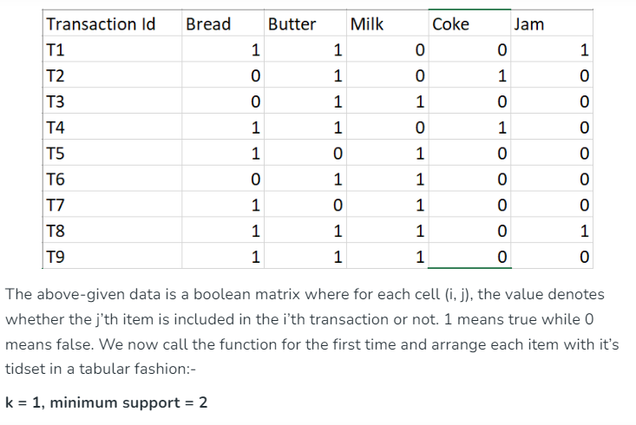
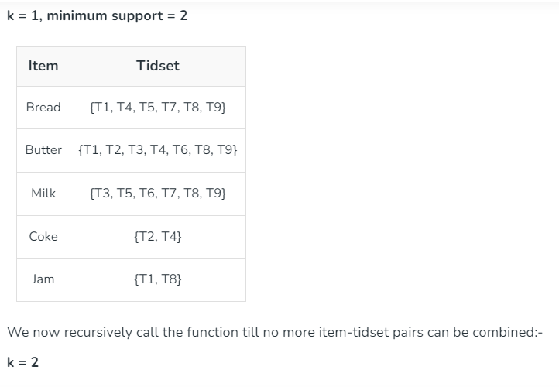
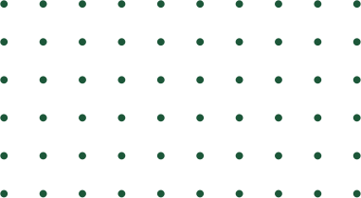
01
02
03
04
05
06
07

Slide 17
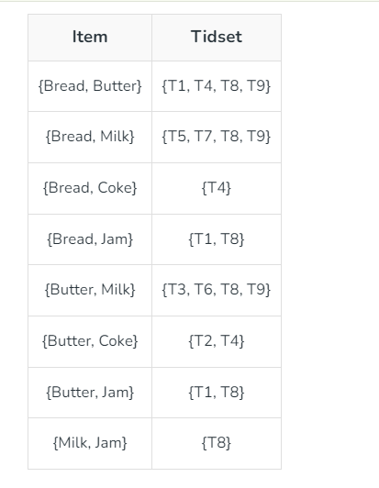
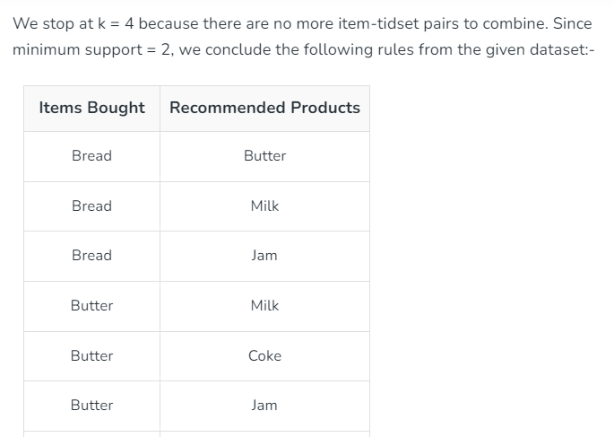
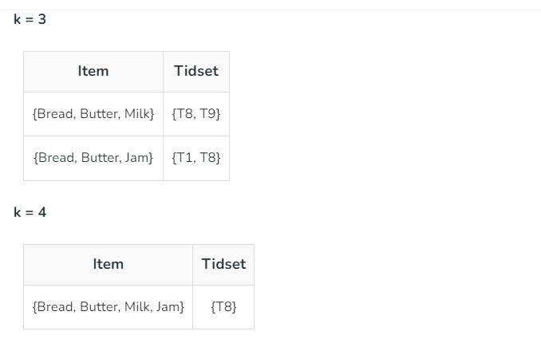
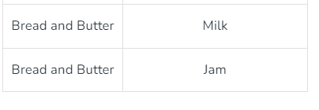

Slide 18
FP GROWTH ALGORITHM
THE TWO PRIMARY DRAWBACKS OF THE APRIORI ALGORITHM ARE:
AT EACH STEP, CANDIDATE SETS HAVE TO BE BUILT.
TO BUILD THE CANDIDATE SETS, THE ALGORITHM HAS TO REPEATEDLY SCAN THE DATABASE.
THE FP-GROWTH ALGORITHM PROPOSED BY HAN IN. THIS IS AN EFFICIENT AND SCALABLE METHOD FOR MINING THE COMPLETE SET OF FREQUENT PATTERNS BY PATTERN FRAGMENT GROWTH, USING AN EXTENDED PREFIX-TREE STRUCTURE FOR STORING COMPRESSED AND CRUCIAL INFORMATION ABOUT FREQUENT PATTERNS NAMED FREQUENT-PATTERN TREE (FP-TREE)..
THIS ALGORITHM WORKS AS FOLLOWS:
L FIRST, IT COMPRESSES THE INPUT DATABASE CREATING AN FP-TREE INSTANCE TO REPRESENT FREQUENT ITEMS.
L AFTER THIS FIRST STEP, IT DIVIDES THE COMPRESSED DATABASE INTO A SET OF CONDITIONAL DATABASES, EACH ASSOCIATED WITH ONE FREQUENT PATTERN.
L FINALLY, EACH SUCH DATABASE IS MINED SEPARATELY.
L USING THIS STRATEGY, THE FP-GROWTH REDUCES THE SEARCH COSTS BY RECURSIVELY LOOKING FOR SHORT PATTERNS AND THEN CONCATENATING THEM INTO THE LONG FREQUENT PATTERNS.

Slide 19
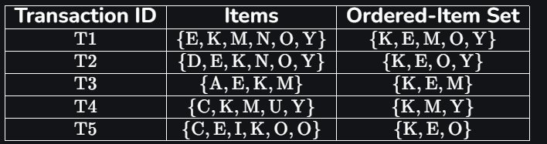
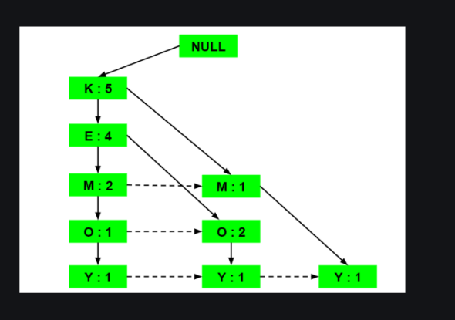
EXAMPLE OF FP TREE

Slide 20
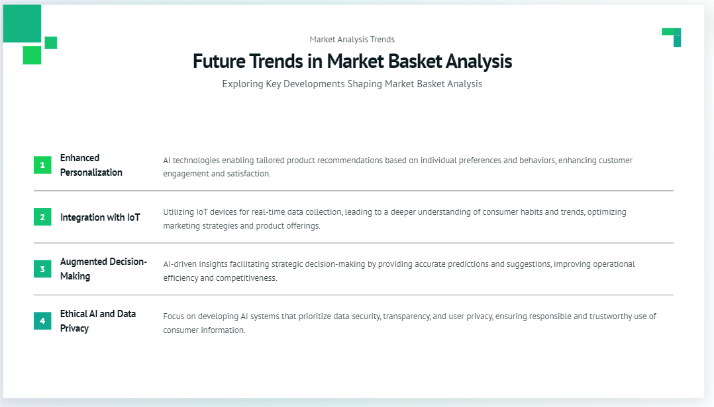

Slide 21
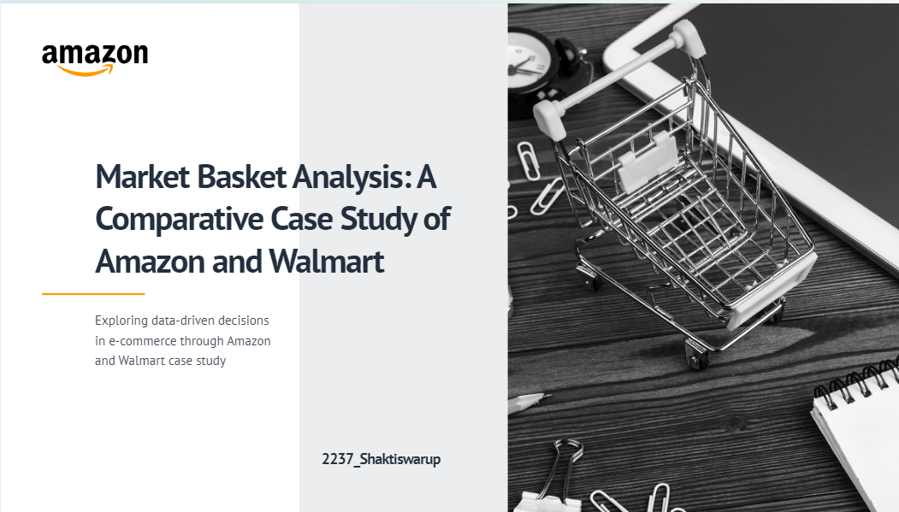

Slide 22
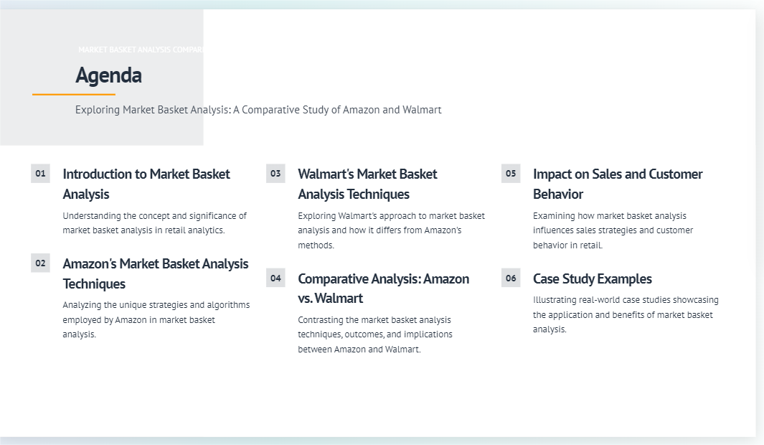

Slide 23
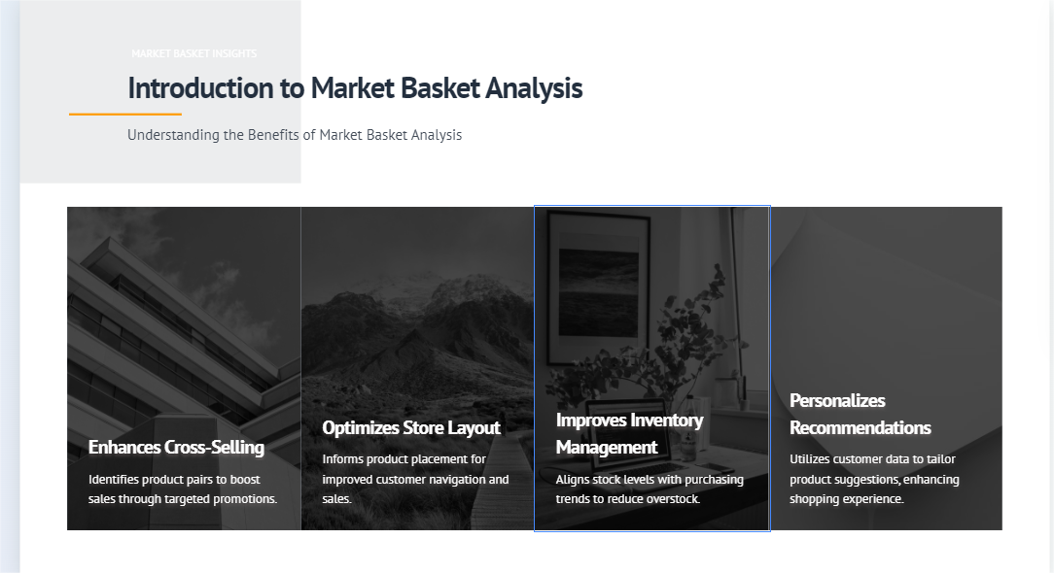

Slide 24
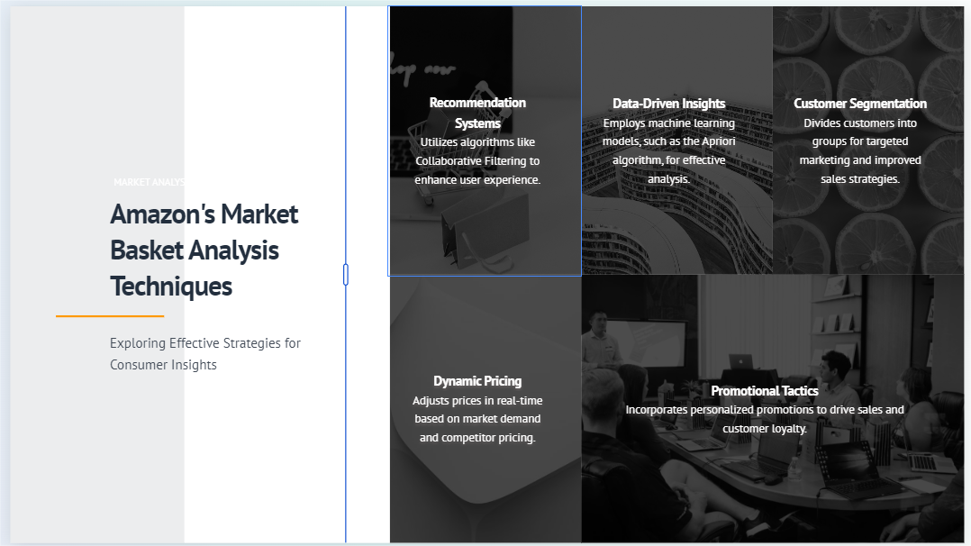

Slide 25
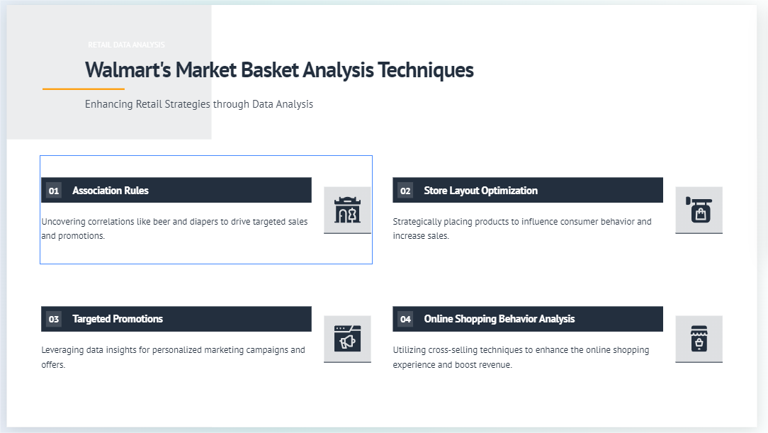

Slide 26
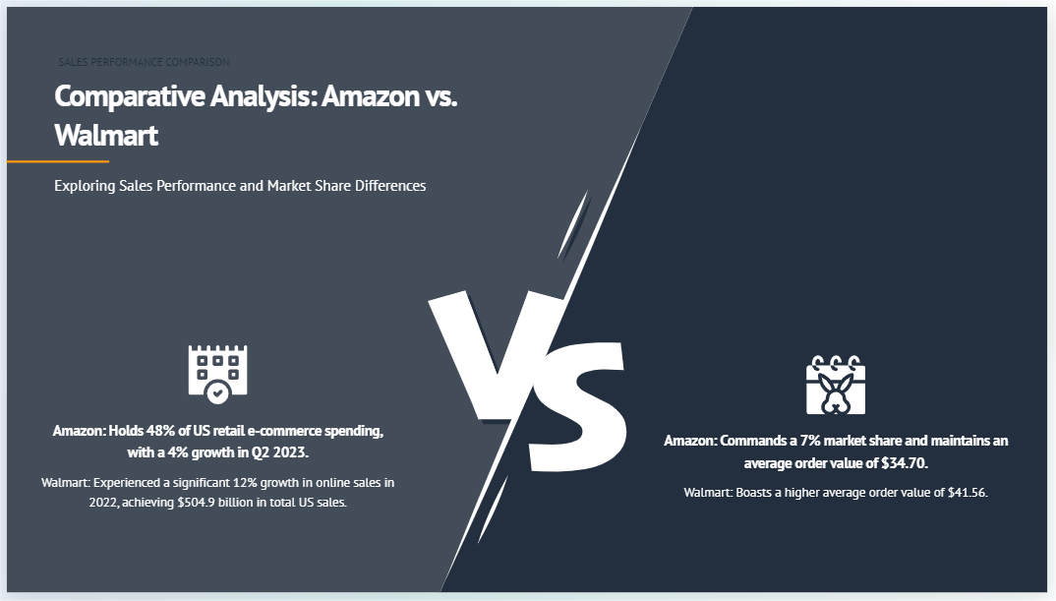

Slide 27
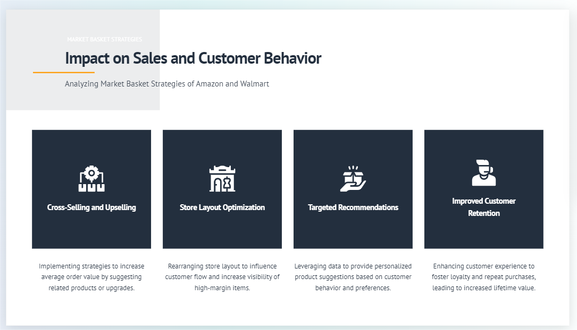

Slide 28
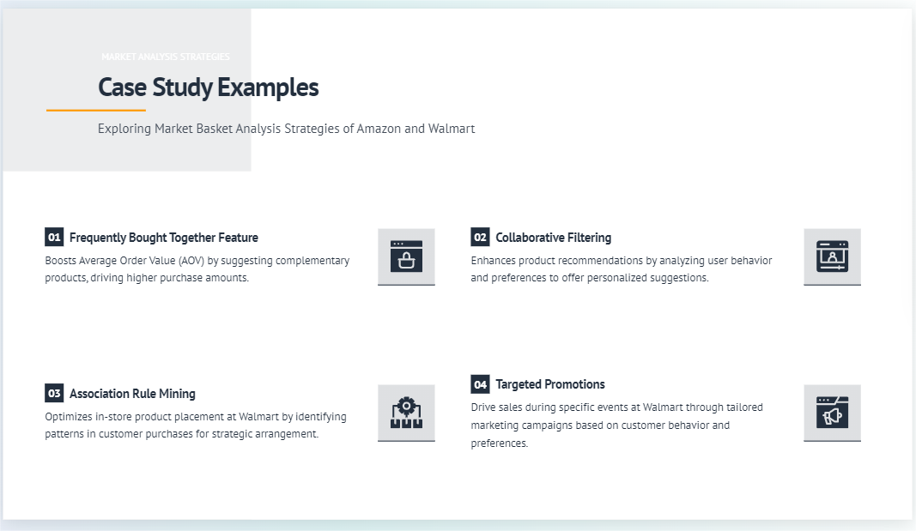

Slide 29
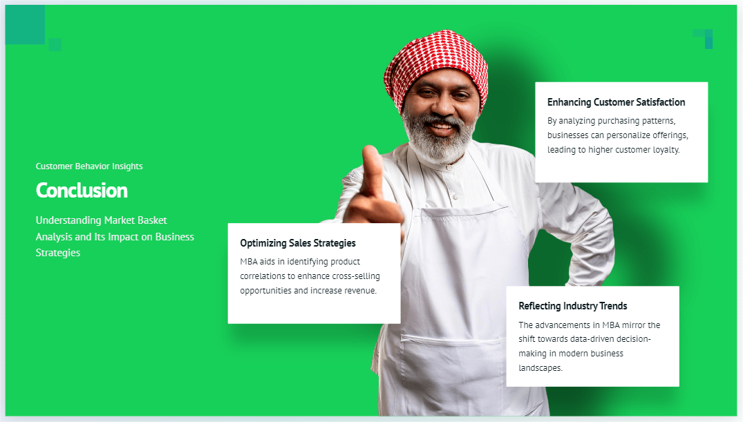

Slide 30
References
1.https://www.analyticsvidhya.com/blog/2021/10/a-comprehensive-guide-on-market-basket-analysis/
2.https://www.techtarget.com/searchcustomerexperience/definition/market-basket-analysis
3. CB4 blog- https://cb4.com/blog/market-basket-analysis/
4. Quantzig Website- https://www.quantzig.com/blog/benefits-market-basket-analysis/#:~:text=Market%20basket%20analysis%20helps%20identify,other%20to%20increase%20the%20sal
5.Research by Anish Garg- https://towardsdatascience.com/association-rules-2-aa9a77241654
6 Geeks for geeks - theory on techniques on algorithms in Market basket analysis
https://www.geeksforgeeks.org/market-basket-analysis-in-data-mining/

Slide 31
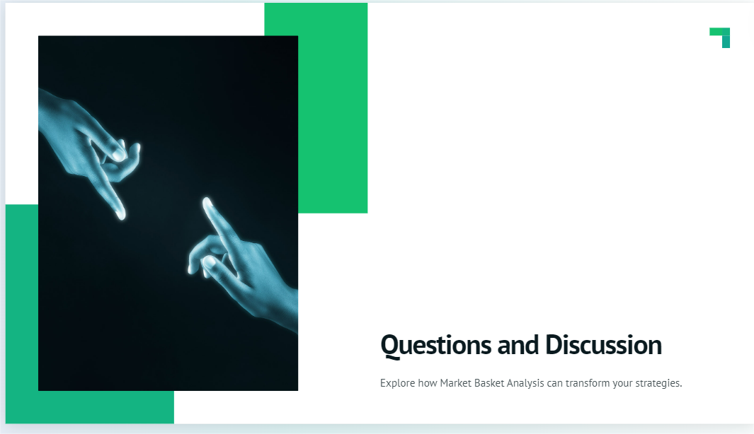

Slide 32
Thank you
PRESENTED BY-GROUP 11
MEMBERS
22052199-DEBABRATA PAUL
22052208-GAYATHRI DEVADAS
22052237-SHAKTISWARUP PRADHAN
22052244-SOHINI CHATTARAJ
22052255-TANISHA BASU

